Slide 2
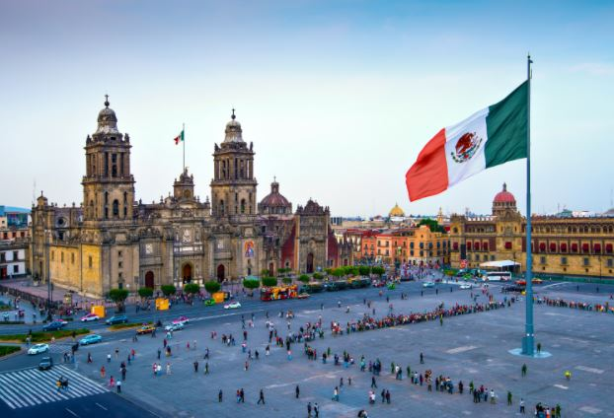
Mexico City is the capital of Mexico. It is one of the largest, most populous cities in the world boasting a current population of 8,851,000 people.

Slide 3
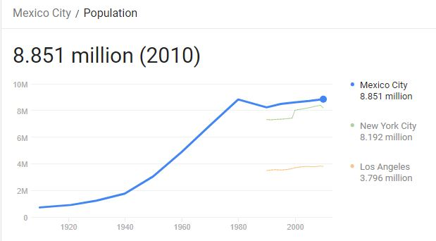

Slide 4
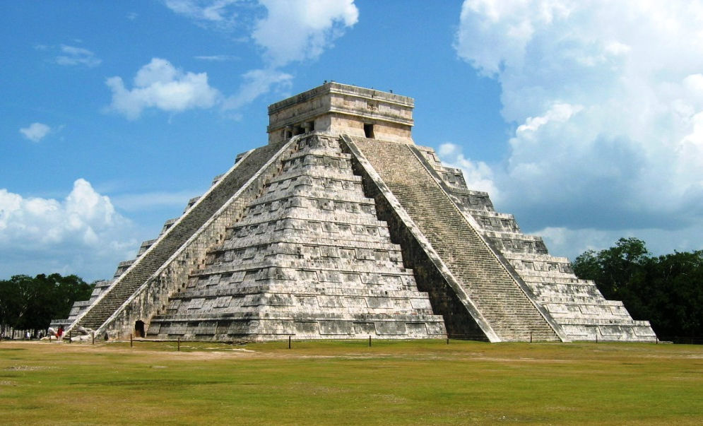
Mexico is home to both Aztec and Mayan ruins. One of the most popular ruins is Chichen Itza. The Mayans built it so that when the sun is positioned exactly over the equator, the shadow of a feathered serpent can be seen on its wall.

Slide 5
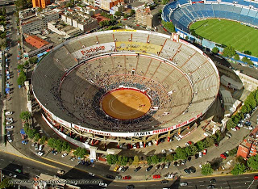
Although soccer is extremely popular in Mexico, bullfighting is the country’s national sport.

Slide 6
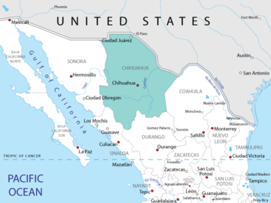
The Chihuahua is the world’s smallest dog & is named after the largest Mexican state.

Slide 7
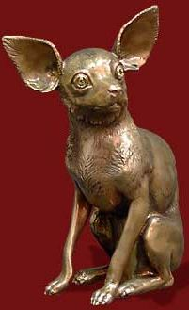
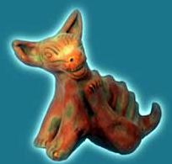
El Chihuahua
Different theories exist as to its origin prior to the 1800’s. There is substantial evidence showing it is a descendent from the Techichi breed
The Techichi breed was originally domesticated during the Maya (1800BC-900AD)
The next civilization to power, the Toltec (900AD-1150AD), continued the use of the Techichi in the homes, as well as for burial
The final civilization before Spanish colonization was the Aztec. They rose to power in 1325AD & used the dogs in not only burial, but also sacrificial & healing rites.
Historians generally accept the idea that some of the earliest Chihuahuas were discovered in Mexico in the late 1800s.
Notes:
http://www.chihuahuawardrobe.com/history-of-the-chihuahua-breed/

Slide 8
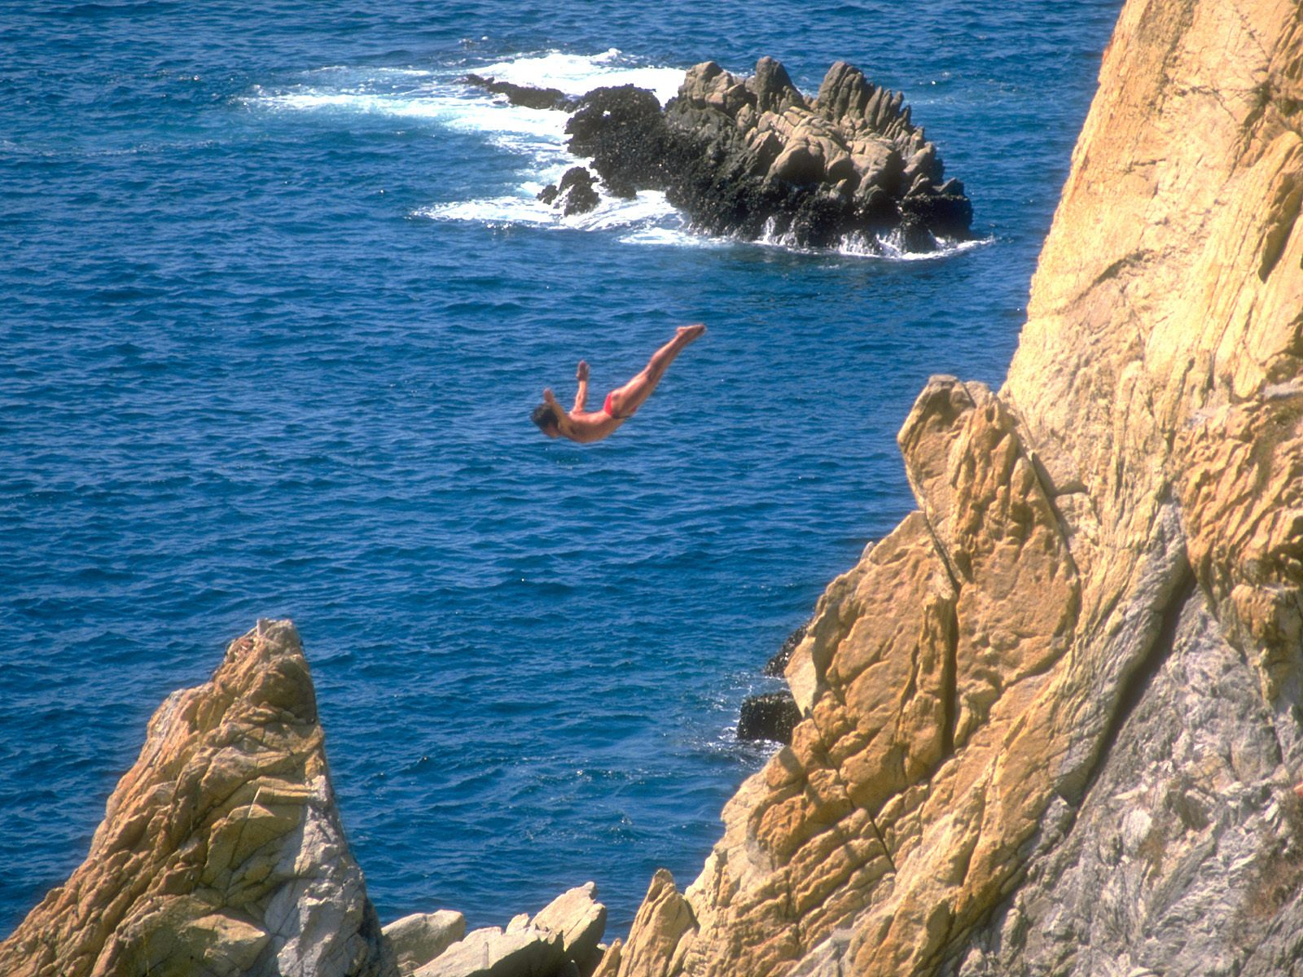
Mexico has many beautiful beaches including Acapulco where you can cliff dive from the famous Quebrada cliff. Adventurous divers jump from a dangerous 135 feet into the ocean below. There’s even a small shrine at the top where the divers pray before jumping.

Slide 9
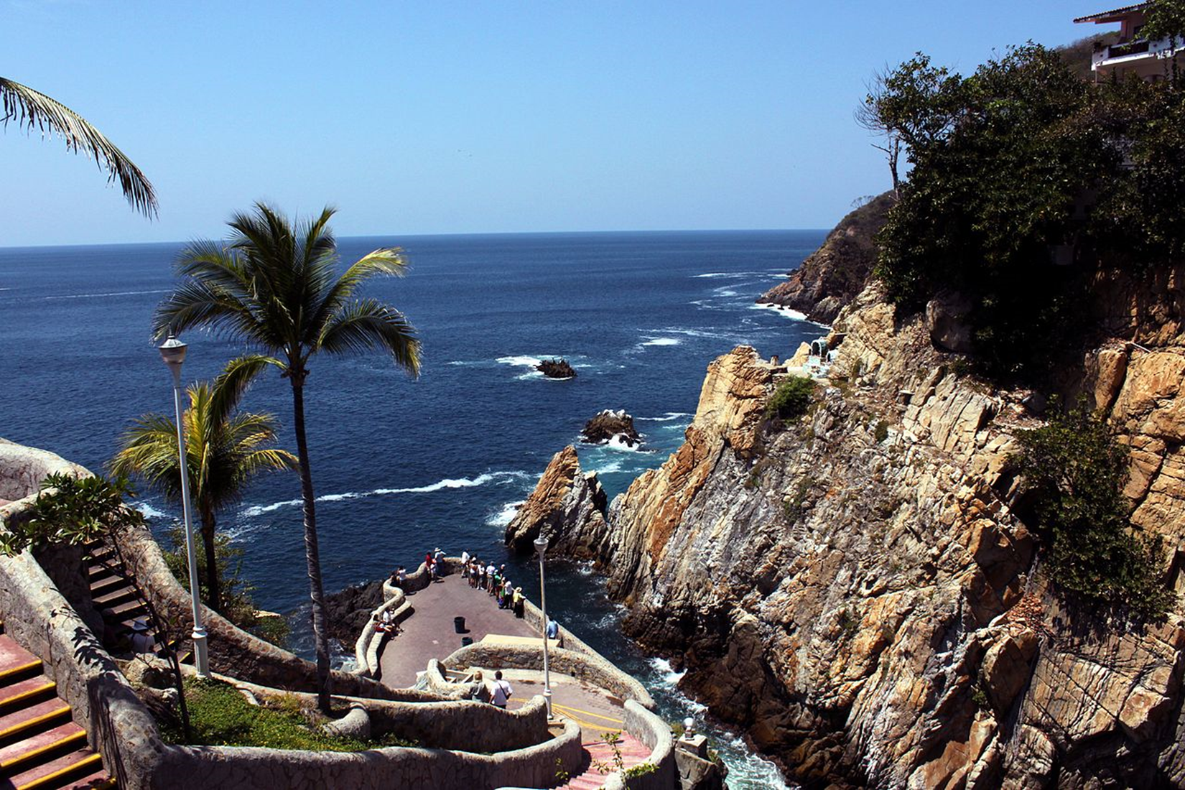

Slide 10
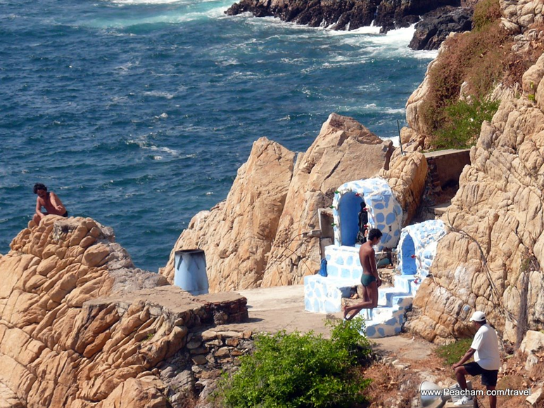

Slide 12
La bandera de México
The three colors of Mexico’s flag hold deep significance for the country and its citizens:
green represents hope & victory
white stands for the purity of Mexican ideals
red brings to mind the blood shed by the nation’s heroes

Slide 13
The flag’s dramatic emblem is based on the legend of how the Mexicas (or Aztecs) traveled from Aztlán to find the place where they could establish their empire. The god, Huitzilopochtli, advised them that a sign—an eagle devouring a serpent atop a Nopal cactus—would appear to them at the exact spot where they should begin construction. On a small island in the middle of a lake, the Mexicas came upon the scene exactly as Huitzilopochtli had described it. They immediately settled there and founded the city of Tenochtitlán, which is now Mexico City, the country’s capital.

Slide 14
In his chronicle of the Spanish Conquest, the soldier Bernal Díaz marveled at the invaders' first glimpse of Tenochtitlán, the Aztec capital set on an island in a vast lake.
After the Spaniards built Mexico City on the ruins of the Aztec city they had destroyed, they conquered the lake waters.
The Aztecs had kept floodwaters at bay through a network of dikes, levees and canals. The Spaniards ignored all that and just began to drain the water.
The result over five centuries is the most drastic reordering of the natural environment that just about any city has carried out.
In place of the five interconnected lakes that formed the heartland of the Aztec Empire, a megalopolis of 20 million people sits today.
Notes:
http://www.nytimes.com/2006/03/16/world/americas/16iht-mexico.html?mcubz=1

Slide 15
Historia en 3 minutos…
http://www.history.com/topics/mexico/distrito-federal

Slide 16
El Día de Independencia mexicano, 16/9/1821
Independence Day is 16 September & celebrates the start of the struggle for independence in 1810.
The war for independence began when the Catholic priest Miguel Hidalgo y Castilla rang the church bells in the village of Dolores & called upon the parishioners to drive out the Spanish.
The revolutionary act was led by the priest Miguel Hidalgo y Costilla & the captains Ignacio Allende & Juan Aldama.
This act—the so-called Grito de Dolores (o Grito de Independencia)—is repeated ritually on the night of 15 September by the authorities throughout Mexico & by ambassadors abroad. The ritual ends with the vigorous shouting of "Viva México" three times.
On the morning of 16 September there are military parades organized by the government.
Independence Day is the most important civic ritual and enjoys broad popular participation.
During the whole month of September houses, offices, and public buildings are decorated with the colors of the Mexican flag.

Slide 17
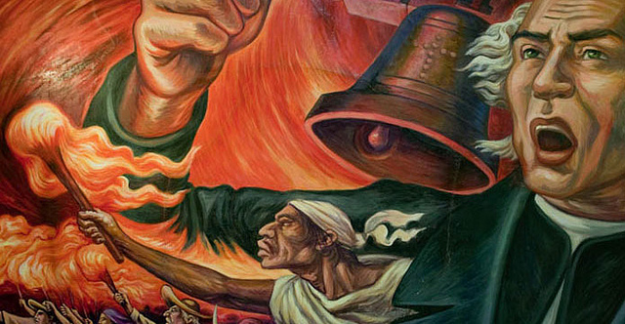
El Grito de Dolores
Notes:
Read more:http://www.everyculture.com/Ma-Ni/Mexico.html#ixzz4KI8UcrvK

Slide 18
El Grito de Dolores (El Grito de Independencia)
¡Mexicanos! (AY)
¡Viva!
¡Vivan los héroes que nos dieron patria!
¡Viva!
¡Viva Hidalgo!
¡Viva!
¡Viva Morelos!
¡Viva!
¡Viva Josefa Ortiz de Domínguez!
¡Viva!
¡Viva Allende!
¡Viva!
¡Vivan Aldama y Matamoros!
¡Viva!
¡Viva la independencia nacional!
(AY)¡Viva México!
(AY)¡Viva México!
(AY)¡Viva México!
Notes:
https://www.youtube.com/watch?v=SIcF_ziSlWU

Slide 20
Baile nacional de México: El Jarabe Tapatio http://folkloricomusicdance.blogspot.com/2006/07/more-famous-dances-of-jalisco-la-negra.html
The Charro (cowboy) would become bolder & try to flirt with the young lady as they danced, since this may be the only time he would approach her in a casual & close manner. The young lady would have fun in being coquettish & flirt back with him, smiling and enticing him as they danced (coquetona). As they would pass each other in the choreography of the dance, the man would attempt to get as close to her as possible, trying to sneak a smile -- and in some cases, even a small kiss -- from her in passing, as they would flirt with each other (much to the chagrin of the chaperone).
In the customary dance the jarabe tapatio (otherwise known in the USA and the rest of the world as the "Mexican Hat Dance"), the Charro would toss down his hat on the ground, & the couple would dance around it, with the Charro chasing her while doing the steps of the dance -- symbolizing the pursuit of man for woman. At the close of the dance, the lady would pick up the hat and lift it over her head -- a symbol of accepting the affection of her suitor, from the old tribal dance of the Huichole indigenous tribe, where the dance originated. The final bars of the dance would sound with the diana --a military march that signified victory. As in all jarabes mexicanos, the pursuit of man for woman ends in triumph for the couple. As this courtship dance finishes with the symbol of marriage, the man kneels in front of his lady and the senorita holds his hat above her head -- the union of man and woman.

Slide 21
El Jarabe tapatío-- el baile nacional de mexico https://www.youtube.com/watch?v=jAcWftwQNQk

Slide 22
El Son de La Negra—el Segundo baile nacional de Mexico
In some sones jaliscienses, such as El son de la Negra, the flirting is exaggerated, the movement is the liveliest, & the rhythms of this vibrant dance excites the emotions of the audience where they will call out or participate, as well.
At the end of the dance, the Charro twirls his partner almost two revolutions, then covers both their heads with his wide-brim hat (sombrero), & finally sneaks a small kiss from the young senorita.
https://www.youtube.com/watch?v=CZHngGx9oss

Slide 23
La familia mexicana
The family is of crucial importance to most Mexicans. Although family members generally live dispersed, sometimes very far away due to international migration, they seek opportunities to gather on several occasions. Family members will occasionally get together for a meal during the weekend, but will more typically gather on religious occasions.
Fictive kinship relations are established through godfathers (padrinos)and godmothers (madrinas) at Catholic baptismal ceremonies.
The family and larger kin groups are the main locus of trust, solidarity, and support in Mexico. These networks are mobilized with diverse objectives such as finding work, establishing political connections, and evading red tape.
Notes:
Read more: http://www.everyculture.com/Ma-Ni/Mexico.html#ixzz4KI8y9cwF

Slide 24
¡Sean creativos! Escribamos un ‘RAFT’

