Slide 1
Responda a las siguientes en frases completas españolas:
¿Cuál es la ciudad capital de Nicaragua?
¿Dónde está Nicaragua?
¿Cuál es la nacionalidad de Nicaragua?
¿Cuándo es el día de independencia de Nicaragua?
¿Cuáles son los otros países que tienen el mismo día de independencia con Nicaragua (5 en todo, incluyendo Nicaragua)?

Slide 2
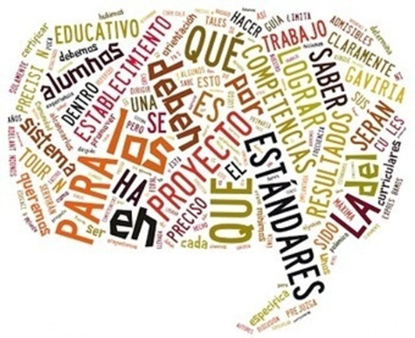
Hoy vamos a…
Aprender de Nicaragua
2.1, 2.2, 3.1, 3.2, 4.1, 4.2, & 5.1

Slide 4
Nicaragua had the first elected woman president of any Central American country. Violeta Chamorro served as President from 1990 until 1997.

Slide 5
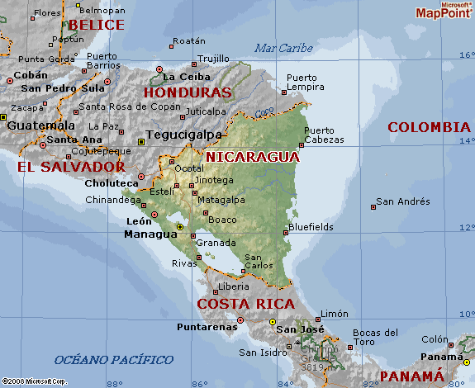
Nicaragua, whose capital is Managua, is located in Central America between Honduras and Costa Rica.

Slide 6
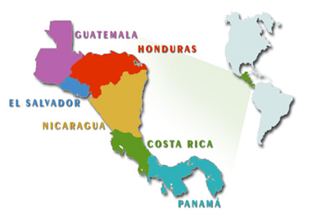
Remember, September 15 was chosen as the starting point for Hispanic Heritage Month because it is the anniversary of the independence of five Latin American countries:
Costa Rica, El Salvador, Guatemala, Honduras, & Nicaragua
They all declared their independence from Spain September 15, 1821.

Slide 7
The Nicaraguan flag has two blue stripes that represent the two oceans that border the country.

Slide 8
The Nicaraguan coat of arms has the following symbols:
a triangle (equality),
a rainbow (peace),
a red hat (liberty),
five volcanoes (the brotherhood between the 5 Central American countries of Nicaragua, El Salvador, Honduras, Costa Rica, & Guatemala).

Slide 9
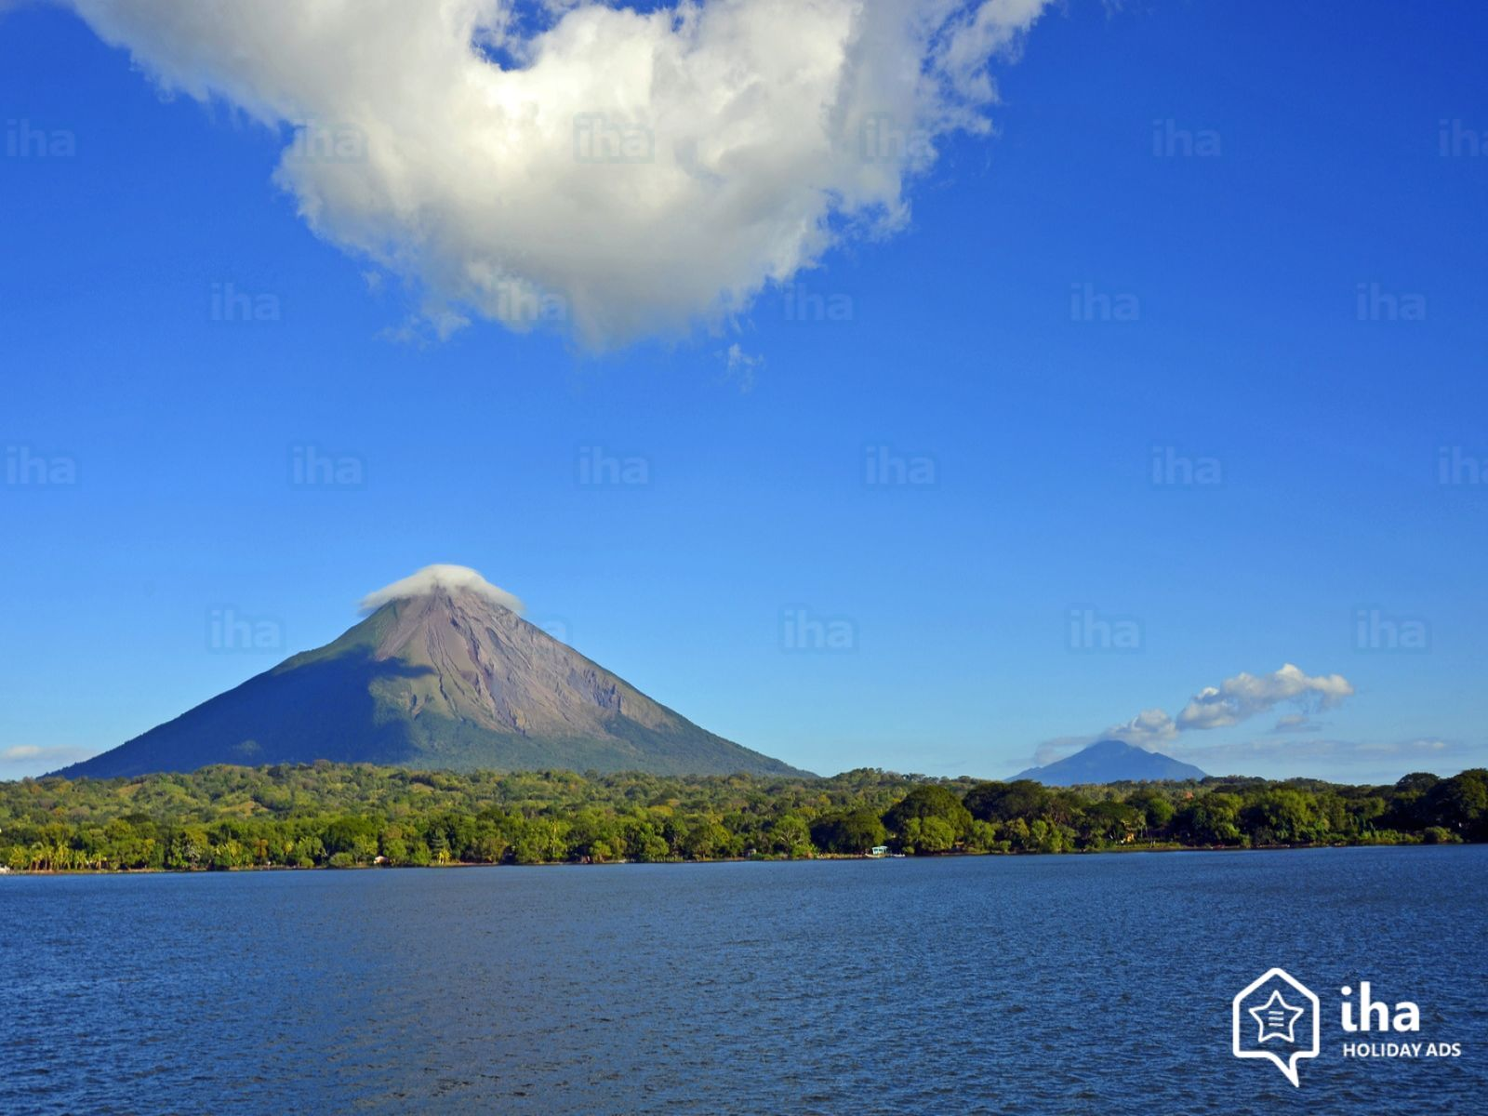
Nicaragua is home to the two largest lakes in Central America:
Lake Managua & Lake Nicaragua.

Slide 11
Lake Managua, Spanish Lago De Managua, lake in western Nicaragua.
Also known by its Indian name, Xolotlán, the lake is fed by numerous streams rising in the central highlands and the Diriamba Highlands. It is drained by the Tipitapa River, which flows into Lake Nicaragua.
The lake is economically significant: its waters yield fish and alligators and are plied by shallow-draft vessels.
Momotombo Volcano, reaching 4,199 feet above sea level, is on the northwestern shore.
Managua, the national capital, lies along the lake’s southern shore.

Slide 12
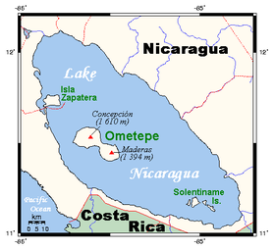
It is believed that Lake Nicaragua, together with Lake Managua to the northwest, originally formed part of an ocean bay
As a result of volcanic eruption, the bay became an inland basin containing the two lakes, which are linked by the Tipitapa River.
The ocean fish thus trapped adapted themselves as the salt water gradually turned fresh.
Lake Nicaragua is the only freshwater lake containing oceanic animal life, including sharks, swordfish, and tarpon.
Notes:
https://www.britannica.com/place/Lake-Nicaragua

Slide 13
There are more than 400 islands in the lake, 300 of which are within 5 miles of the city of Granada on the northwest shore.
Most of the islands are covered with a rich growth of vegetation, which includes tropical fruit trees.
Some of the islands are inhabited. Ometepe is 16 miles long & 8 miles wide.
The lake is formed of what originally were two separate volcanoes—Concepción, which is 5,282 feet high & last erupted in 1983, and Madera, which is 4,573 feet high. Lava from bygone eruptions forms a bridge between them, called the Tistian Isthmus.
Notes:
https://www.britannica.com/place/Lake-Nicaragua

Slide 14
Ometepe Island is the preeminent site in Nicaragua for pre-Columbian examples of statuary, ceramics, and other archaeological remains, some of which are believed to represent vestiges of ancient South American, as well as North American, civilizations.
Notes:
https://www.britannica.com/place/Lake-Nicaragua

Slide 15
Día de Independencia nicaragüense, 15/9/1821
At present, September is celebrated as the patriotic month. The commemorative activities carried out by schools and institutions begin the first day of September.
Like in the US, the Nicaraguan flag is much more visible during September appearing in homes as well as official buildings.
La antorcha encendida: Every year during the month of September a lit torch travels across Central America, from Guatemala to Costa Rica. It is carried on foot & is handed onward at each country’s borders. It begins in Guatemala on September 1st & runners run it through the country southward. It passes through El Salvador & then Honduras, towards Nicaragua. The torch arrives on September 11 at Las Manos, the northern Nicaraguan border, & is exchanged by the ministers of education of Honduras & Nicaragua in the morning. Then, it begins to travel the country by the Panamerican Highway, & is handed off between runners who are the best students of the schools in each municipality. They will walk or run with the torch in their hands a maximum of just over half a mile. A total of 387 kilometers are covered by over 8,000 students.
Notes:
https://vianica.com/sp/go/specials/5-independencia_Nicaragua.html

Slide 16
Notes:
https://vianica.com/sp/go/specials/5-independencia_Nicaragua.html

Slide 17
La Batalla de San Jacinto hacienda:
Among the people who promoted the Central American Independence from Spain was the Nicaraguan, Miguel Larreynaga.
There was unrest after Spanish independence in 1821 & the US invaded Nicaragua with intent to take over. Thus, the Battle of San Jacinto took place to earn true independence in 1856.
The famous patriotic battle, which marked the beginning of the defeat of the North American filibusters throughout the country, happened casually on September 14, a day before independence was celebrated.
Nicaraguan sergeant Andrés Castro had difficulty maintaining his position & his weapon got stuck.
When a mercenary soldier crossed his trench, he took a stone & threw it at the head of the enemy with such power that it killed him from the blow.
Notes:
https://vianica.com/sp/atractivo/144/sitio-historico-hacienda-san-jacinto

Slide 18
Baile folklórico de Nicaragua: Baile de Gigante
Notes:
http://www.taringa.net/posts/info/14973876/Bailes-Tipicos-y-Cultura-Nicarag-ense.html
https://www.viajejet.com/bailes-tipicos-de-nicaragua/#la-gigantona-y-el-enano-cabezon

Slide 20
Gallo pinto (meaning “spotted rooster”) is the typical dish of Nicaragua. It consists of rice and beans fried together with cilantro, onions, and peppers.

