Slide 1
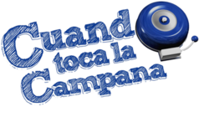
Responda a las siguientes con verdad o falso:
The capital city of La República Dominicana is the oldest in the ‘new world:’ La Habana.
The Cuban Son was heavily influenced from African rhythms & is the base of the salsa music rhythms that we know today.
Ecuador is both the name of a country & the name of the Equator in Spanish.
Both here in the USA & in Ecuador we have the cultural perspective that Friday the 13th is bad.
Ecuador’s official language is Spanish, but ten other native languages are still spoken like Quechua.
Blue is a color on the flags of Uruguay, Puerto Rico, La República Dominicana, Cuba, & Ecuador, though it has carried different symbolism.
Hispanic Heritage Month is a US celebration which began as a week in 1968 under Pres. Johnson.
Bernardo de Galvez was a contemporary of George Washington.
Hispanic Civil Rights leader, Dr. Hector P. Garcia’s, ideology of justice for all in the 1940-50’s paved the way for Dr. Martin Luther King Jr.’s platform in the civil rights movements of the 1960s.
Dios, Patria, y Libertad & the Bible are featured on the coat of arms for La República Dominicana.

Slide 2
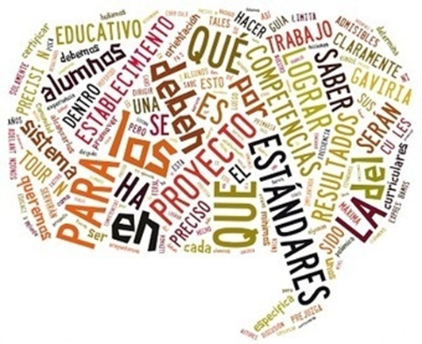
Hoy vamos a…
Hacer el trabajo de la campana
Aprender de Perú
2.1, 2.2, 3.1, 3.2, 4.1, 4.2, & 5.1

Slide 3
What is a crop circle?
Who makes/made crop circles?
Of what is the picture to the right?
Where can you find it?
Where in the world do potatoes come from (ie where they grow in the wild)?

Slide 4
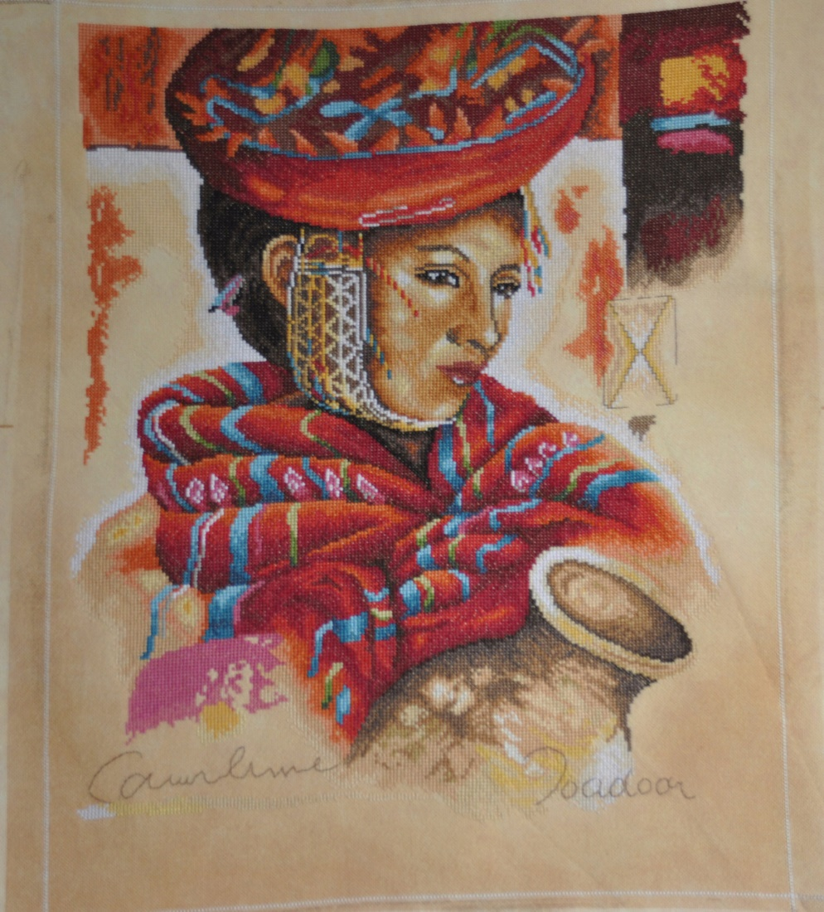
PERÚ
©2015 Sra. Cruz

Slide 5
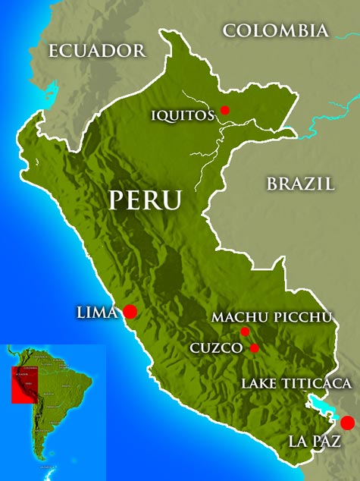
Perú, whose capital is Lima, is located on the western coast of South America & is about the same size as Alaska.
©2015 Sra. Cruz

Slide 6
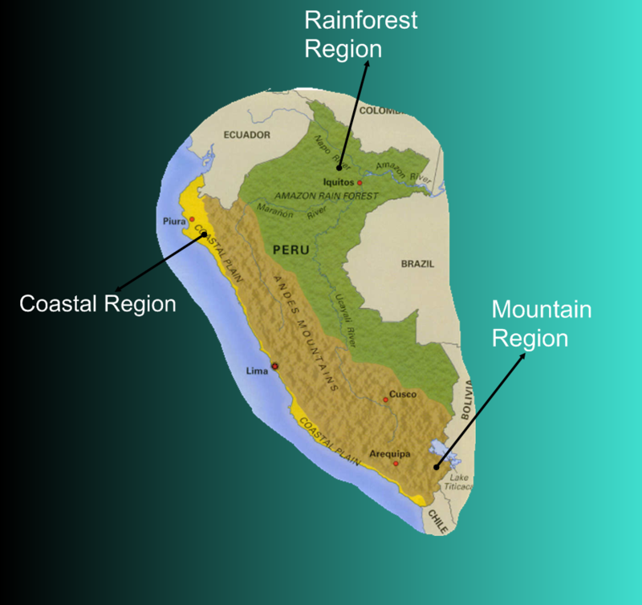
In Peru there are 3 climate zones:
a desert coastal strip (called la Costa), with a mild climate, cloudy & foggy in winter and pleasantly warm in summer;
the Andean zone (la Sierra), more or less cold depending on altitude
the large eastern area covered by the Amazonian forest (la Selva), with a hot & humid climate throughout the year.
Notes:
http://www.climatestotravel.com/climate/peru

Slide 7
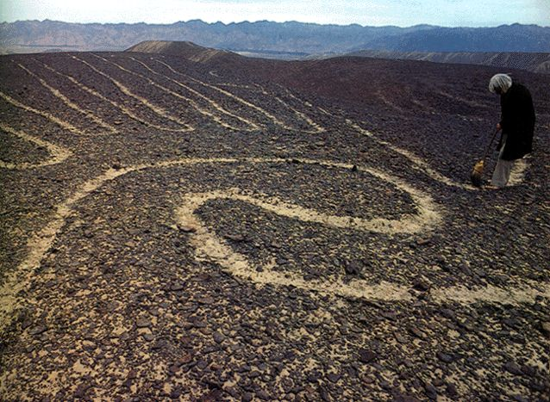
The Nazca lines in Peru were created by the Nazca civilization over 1300 years ago. They are only visible by air and it is believed that the Nazca people created them for their gods. The largest figure measures almost 900 feet long.

Slide 8
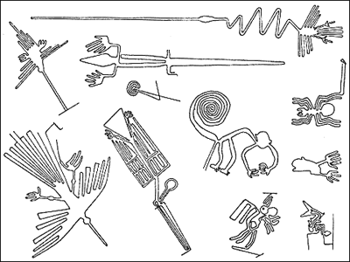
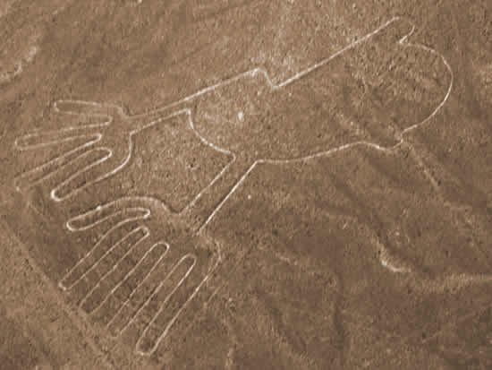
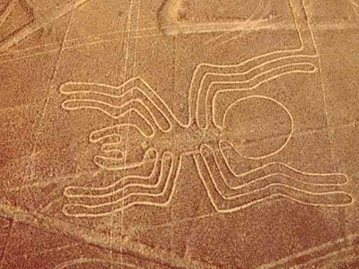

Slide 9
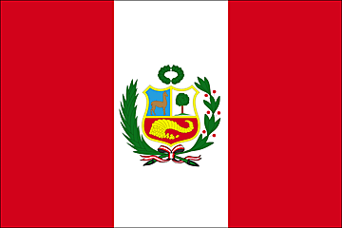
El Día de Independencia:
28 de julio, 1821.
The current flag of Peru was officially adopted on February 25, 1825.
José de San Martín, known as The Liberator, designed the flag.
José de San Martín was a Spanish-born, Argentine soldier, statesman, & national hero who helped lead the revolutions against Spanish rule in Argentina (1812), Chile (1818), & Peru (1821).
José de San Martín worked with Simon Bolivar, who freed Venezuela, Colombia & Ecuador from Spanish imperial rule.
Notes:
http://respuestas.tips/cual-es-el-significado-de-los-colores-de-la-bandera-peruana/
https://www.britannica.com/biography/Jose-de-San-Martin
http://www.historytoday.com/richard-cavendish/liberation-peru

Slide 10
Groups of historians have researched & theorized the following possible meanings of the colors of the flag:
José de San Martínwanted to take the colors of Argentina (white) and Chile (red), because both countries were part of the liberating army.
José de San Martínchose those colors after the flamencos (parihuanas), aquatic birds of elongated body, slender and with white feathers with red and black spots. These birds abound in the Bay of Paracas & they flew over the liberating squadron at the time of their disembarkation.
Lastly, the colors are said to symbolize the Incas and their lasting impact on the country. Red was the Incan color of war because it symbolized the generous blood of those admirable heroes & martyrs; while the white of represents the purity, freedom, social justice, & peace.
Notes:
http://respuestas.tips/cual-es-el-significado-de-los-colores-de-la-bandera-peruana/

Slide 11
The Shield of Peru is a patriotic symbol composed of three fields that represent the three kingdoms of nature present in the Peruvian territory: Rainforest, Coastal, Mountain.
In the upper left side of the shield of Peru is the vicuna in light blue. The color represents the clear, Andean sky. The vicuna represents the Peruvian fauna & is of fine texture, graceful & slender.
To the upper right side is the Quina or Cinchona tree on a white background. The tree represents the Peruvian flora & is considered as a curative of human pain. It symbolizes magnanimity.
Finally, at the bottom of the Shield is the Cornucopia that is spilling gold coins. This object symbolizes the Peruvian mining wealth & points out the abundance of resources that Peru has.
Notes:
http://respuestas.tips/cual-es-el-significado-de-los-colores-de-la-bandera-peruana/

Slide 12
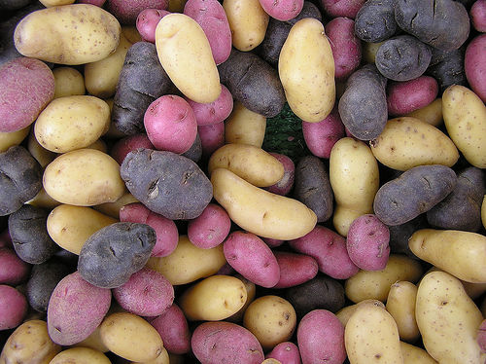
Potatoes are originally from Perú and they produce over 3000 different varieties.

Slide 13
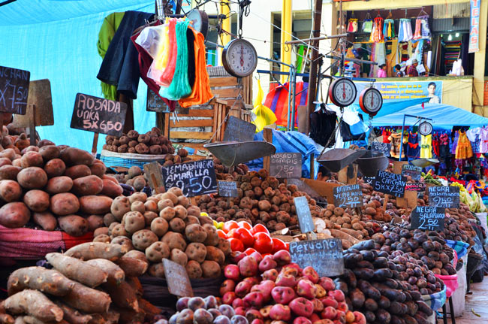
Though many theories are taught concerning the origin of potatoes, genetic testing revealed their origin as Peru.
Potatoes grow wild in Peru, but the Incan Indians began cultivating them as early as 8000 B.C. to 5000 B.C.
The potato is the world’s fourth largest food crop, following rice, wheat, and maize.
In 1536 Spanish Conquistadors conquered Peru, discovered the flavors of the potato, & carried them to Europe.
Before the end of the sixteenth century, families of Basque sailors began to cultivate potatoes along the Biscay coast of northern Spain.
Sir Walter Raleigh introduced potatoes to Ireland in 1589 on the 40,000 acres of land near Cork.
It took nearly four decades for the potato to spread to the rest of Europe.
Notes:
https://www.potatogoodness.com/potato-fun-facts-history/
http://quatr.us/food/potatoes.htm

Slide 14
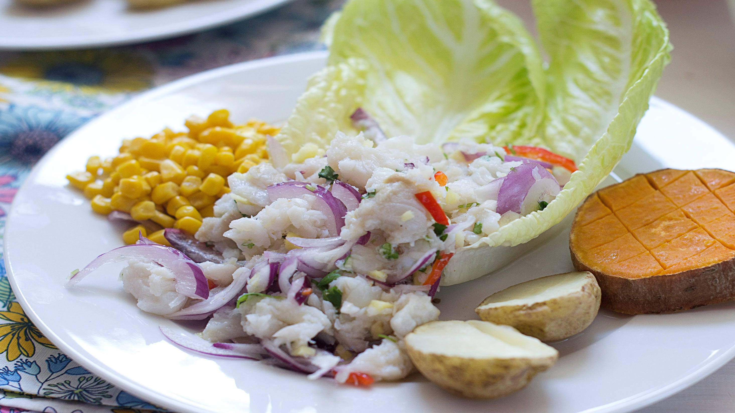
Ceviche is a typical dish in Peru. It consists of raw seafood that is marinated in citrus juices, usually lemon.

Slide 15
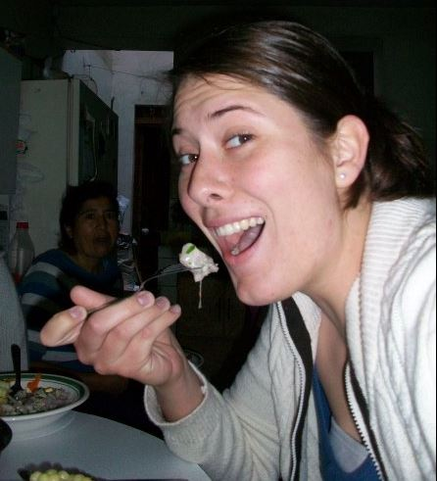
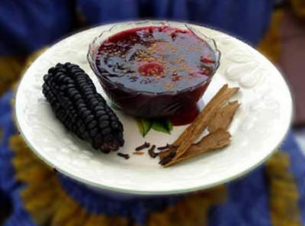
Our VERY Peruvian cuisine. Ceviche is made of raw fish, lemon juice, and raw onions with other flavorings. ChiCha Morada is a type of drink here made from black corn. See below for all other foods.— with SOUP!, ChiCha Morada, Cancha (roasted corn kernels), Camote or Sweet Potato, HUGE-kernel-ed Corn and Ceviche

Slide 16
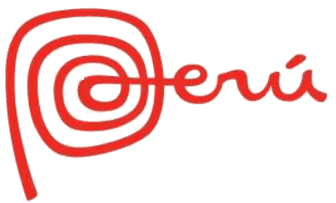
The Huayno was the most well-known dance in the Incan Empire.
It is the most traditional, folkloric dance done in the Andes mountain villages.
The dance name, huayno, comes from the quechua Word huañuy, which means death. It symbolizes the Spaniards arrival to South America & the falling of the Incan Empire to them. However, it also is connected to the Quechua word "huayñunakunay" which means, “to dance with the hands tied.”
The Huayno has different versions based on where it is being danced due to the traditions of the specific locale or region.
It is a dance of happiness. The message between the pairs dancing el Huayno usually is that of falling in love, but also shows falling out of love & the emotional suffering therein
It is especially common in Peru, but also present in Chile, Bolivia, Argentina and Ecuador, & is practiced by a variety of ethnic groups, especially the Quechua people.
Huayno utilizes a distinctive rhythm in which the first beat is stressed and followed by two short beats. High-pitched vocals are accompanied by a variety of instruments, including quena (flute), harp, siku (panpipe), accordion, saxophone, charango, lute, violin, guitar, and mandolin.

Slide 17
Huayno Peruano https://www.youtube.com/watch?v=HiS4V1mMhes

Slide 18
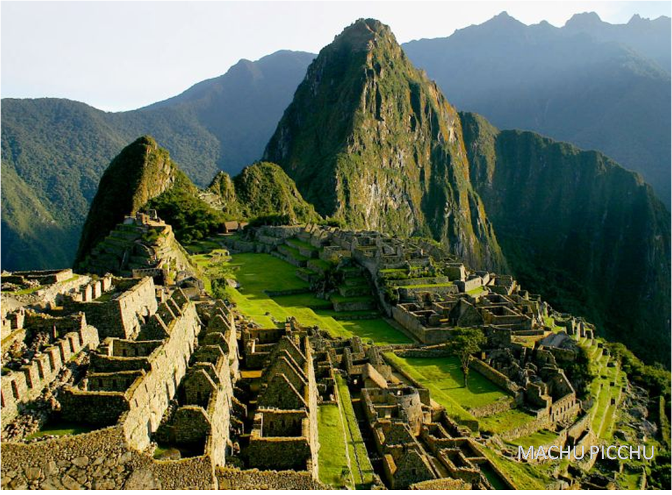
Perú was home to the ancient Inca civilization. Machu Picchu, which is thought to be the “Lost City of the Incas,” was recently named as one of the new 7 wonders of the world.

Slide 19
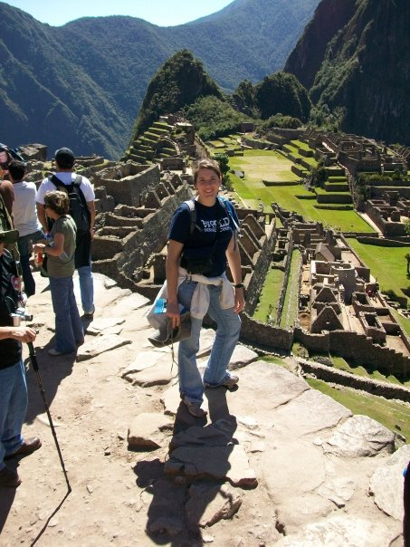
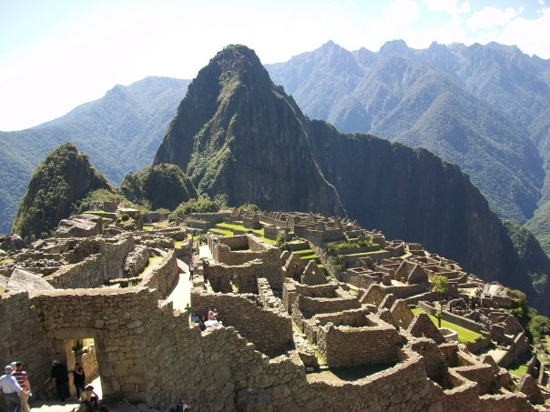
Machu Picchu
http://www.history.com/topics/machu-picchu/videos/machu-picchu
Notes:
http://travel.nationalgeographic.com/travel/top-10/peru/machu-picchu/secrets/#page=2

Slide 20
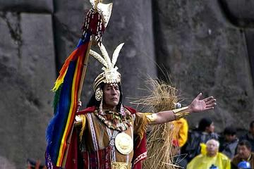
Religión
El Sol o Inti, era la divinidad más importante en todo el Tahuantinsuyo y considerado el "padre de los incas", por ello eran denominados "hijos del sol". Los cronistas indican que el Inti fue representado mediante una estatuilla pequeña esculpida en oro. Entre los templos dedicados al Inti, el más importante era el Coricancha ubicado en el Cusco. En la plaza central del Cusco se realizaban actos ceremoniales masivos como culto solar.
The sun, Inti, was the most important divinity for the Incans & was considered the father of them. They were thusly referred to as the sons of the sun. There are indicators that Inti was usually represented by an idol made of gold.
The most important temple for Inti was called Coricancha & was located at Cuzco. The central plaza in Cuzco is where they acted out ceremonies.
Notes:
http://travel.nationalgeographic.com/travel/world-heritage/machu-picchu/#/wide-machu-picchu-temple-of-the-sun_92491_600x450.jpg

Slide 21
Perú
¿Cuál es la ciudad capital y nacionalidad?
Día de independencia, año, y país:
¿Cuál cultura anciana era en Perú?
¿Dónde está Perú?
¿Cuáles son los colores de la bandera peruana?
¿Qué significa la bandera?
Who chose the flag?
How many climates does Peru have & what are they?
What are the Nazca lines?
What is some food of Peru?
What is Huayno?
Lima y peruano(a)
El veintiocho de julio 1821 de España
Incas
En Sudamérica (América del Sur, Sur América).
Rojo, blanco, con un símbolo
The colors represent the Incas. The symbol has a llama, chichona tree, both important to Peru, & cornucopia representing prosperity
Jose de San Martin, The Liberator of Peru
3: desert (coast), rainforest, & mountain
Crop lines created in shapes, are only seen by air, over 1300 years ago by the Nazca people for their gods. The longest is over 900 feet
Potatoes (over 3000 variations), ceviche, chicha morada, cancha
A dance originally from the Incas. Name comes from Quechua. Flute is main
Instrument used. Mostly danced in the Andes. It is a song of happiness about falling in love, although the name reminds of ‘death’ for what happened to the Incan empire when the Spaniards came.

